Slide 1

Victoria Unemployment & Crime
Prediction
COMP90024
Cluster and Cloud Computing
Team 11

Slide 2





Our team

Slide 3
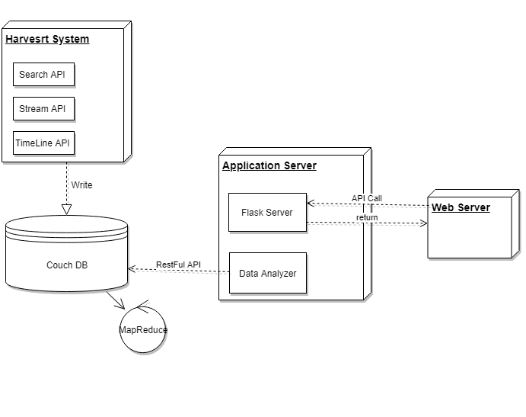
System design

Slide 4

Docker structure

Slide 5
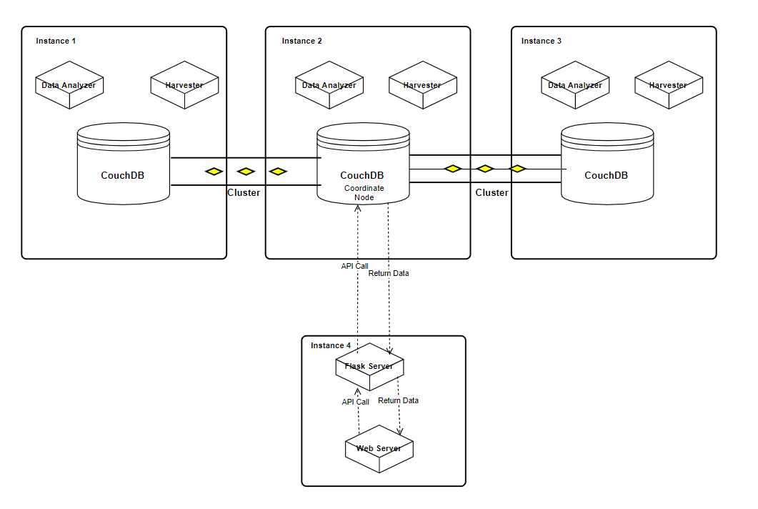
Physical structure

Slide 6
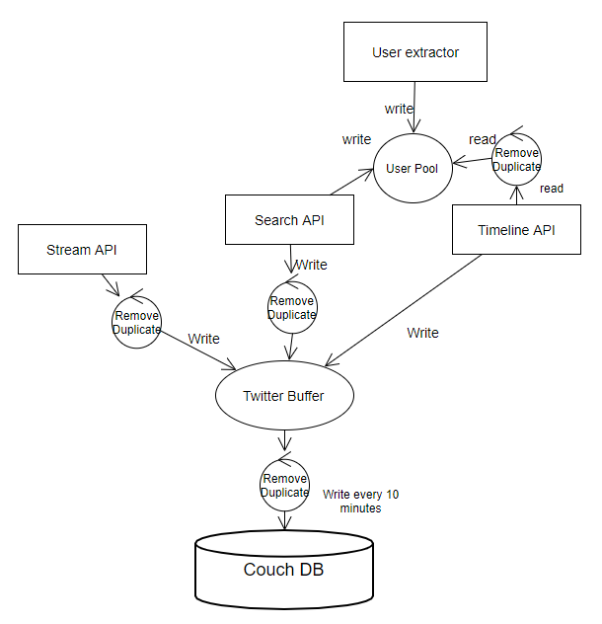
Twitter Harvesting

Slide 7
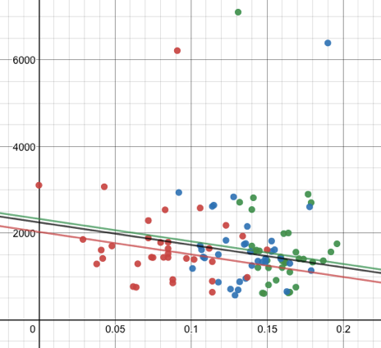
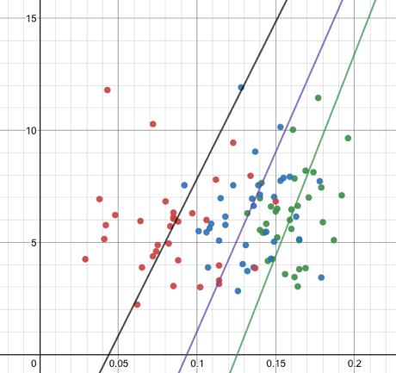
Regression analysis
OFFENCE RATE
UNEMPLOYMENT RATE

